Slide 1
CHATBOT FOR COLLEGE WEBSITE.
BY Kolluri Vishnu.
From IARE.

Slide 2
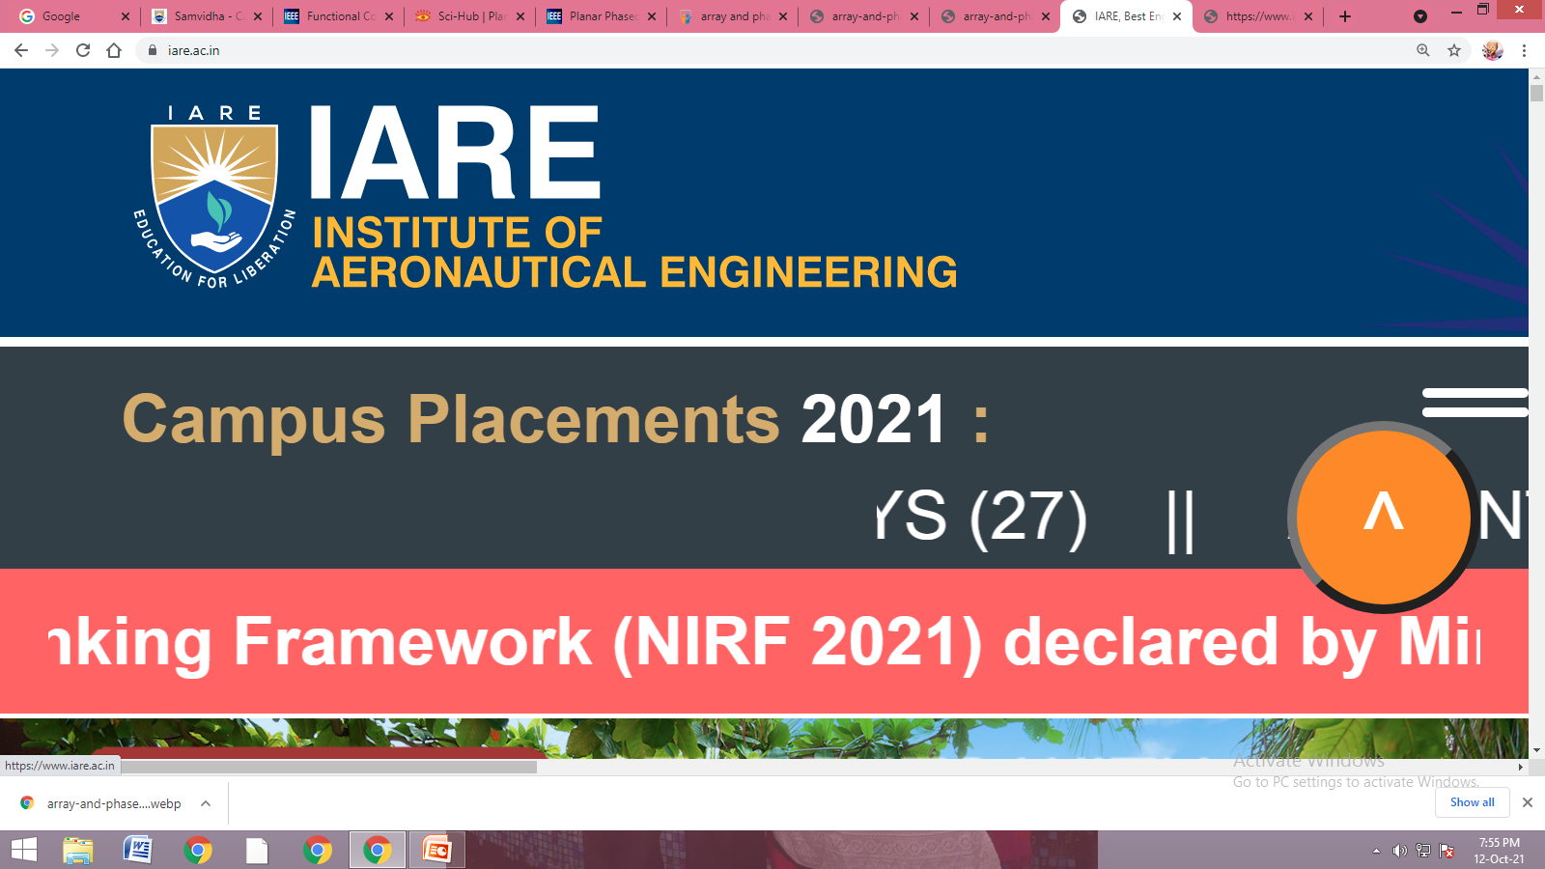
ABSTRACT
A Software application designed to simulate conversation with human users, especially over the internet is known as Chatbot.
Usually they work on Artificial intelligence and Machine learning platforms. Chatbots are increasingly present in businesses and often are used to automate tasks that do not require skill-based talents.
In this project I am going to develop Chatbot using Python in Anaconda Jupyter notebook software and Chatbot will give output both in the form of text and Speech.

Slide 3
INTRODUCTION
Chatbot provides live interaction with human and give response in text or Speech.
Natural Language Processing is used to develop Chatbot. nltk is a Python Library used for natural language processing which automatically generate responses.
Training
Creating GUI
Testing
Measuring its Accuracy

Slide 4
Flowchart
start
Input
Checking for answer
Output in text and speech
Yes
Any new input
No
end

Slide 5
SIGNIFICANCE
Eliza is the first chatbot developed in late sixteens.
Nowadays chatbots became very famous for mainly two reasons:
Due to emergence of messenger applications like Whatsapp, facebook messenger, telegram etc.
Due to emergence of Artificial Intelligence (AI).
Chatbots reduces human work since it provides basic information to customers related to particular domain.

Slide 6
OBJECTIVES
To create a chatbot for college website so that it can respond both in the form of text and speech.
To use text files which consist of information about college like its location, NIRF ranking, number of placements, number of courses offered, number of Faculty available, extra curricular activities, brochure etc for training Chatbot.
To create GUI which consists of options for changing fontsytle, theme of GUI for better visibility.
SOFTWARE USED:
Jupyter notebook
LIBRARIES USED:
nltk, numpy, random, string, Tkinter, pyttsx3, time, threading, sklearn libraries used

Slide 7
PROPOSED METHOD
TRAINING CHATBOT:
Step1: Opening text files in read mode which are used to train chatbot .
Step2: Downloading punkt which is a sentence tokenizer divides text into list of sentences.
Downloading WordNet database which consists of English Nouns, Adjectives, Adverbs etc.
Step 3 : Tokenizing text files using sentence tokenizer and word tokenizer.
Step 4: Using lemmatizer , which is used to analyze meaning behind the words.

Slide 8
Step 5: In sk-learn module, we use Tfidfvectorizer to convert words into list of vectors .
Using cosine similarity checking similarity between vectors.
We will convert list of vectors into one dimensional array using flatten command.
CREATING GUI :
Step 1: Using tkinter we can create graphical user interface (GUI) .
We will create a new hierarchical menu like File, Options, Help using add_cascade.
We will add item like font, color theme to the menu using add_command.
We will configure certain options in the GUI.

Slide 9
Step 2: Using Frame in tkinter creating buttons like send, close etc.
Step 3: Using time module generating present time and displaying it on the GUI .
GENERATING RESPONSE:
Step 1: Checking cosine similarity of the question asked by the user and text present in text files.
Step 2: Generating random response present in text files using random module.
Step 3: Using print function and pyttsx3 module displaying output in the form of text and Speech.

Slide 10
TESTING CHATBOT :
Testing Chatbot whether it is giving correct response to the questions asked by the user or not.
Finally measuring Accuracy of the chatbot and improving Accuracy .

Slide 11
CONCLUSIONS
Human language can be transformed into the data transformation with the help of NLP. With the help of NLP, we can easily develop Chatbot.
As Chatbot will respond both in the form of text and speech it will be more interactive for humans to communicate with it.
Not only that Chatbot will increase the customer base by enhancing the customer support services, thereby helping to increase sales. Nowadays Chatbots are increasing day by day due to its various Applications in real world.
Finally chatbots represent new trend in how people access information, make decisions and communicate.

Slide 12


